Slide 1

PowerPoint Slides
Processor Design
The Language of Bits
Computer Organisation and Architecture
Smruti Ranjan Sarangi, IIT Delhi
Chapter 9 Principles of Pipelining
PROPRIETARY MATERIAL. © 2014 The McGraw-Hill Companies, Inc. All rights reserved. No part of this PowerPoint slide may be displayed, reproduced or distributed in any form or by any means, without the prior written permission of the publisher, or used beyond the limited distribution to teachers and educators permitted by McGraw-Hill for their individual course preparation. PowerPoint Slides are being provided only to authorized professors and instructors for use in preparing for classes using the affiliated textbook. No other use or distribution of this PowerPoint slide is permitted. The PowerPoint slide may not be sold and may not be distributed or be used by any student or any other third party. No part of the slide may be reproduced, displayed or distributed in any form or by any means, electronic or otherwise, without the prior written permission of McGraw Hill Education (India) Private Limited.
1

Slide 2

These slides are meant to be used along with the book: Computer Organisation and Architecture, Smruti Ranjan Sarangi, McGrawHill 2015
Visit: http://www.cse.iitd.ernet.in/~srsarangi/archbooksoft.html

Slide 3

Outline
Overview of Pipelining
A Pipelined Data Path
Pipeline Hazards
Pipeline with Interlocks
Forwarding
Performance Metrics
Interrupts/ Exceptions

Slide 4
Up till now ….
We have designed a processor that can execute all the SimpleRisc Instructions
We have look at two styles :
With a hardwired control unit
Microprogrammed control unit
Microprogrammed data path
Microassembly Language
Microinstructions

Slide 5
Designing Efficient Processors
Microprogrammed processors are much slower that hardwired processors
Even hardwired processors
Have a lot of waste !!!
We have 5 stages.
What is the IF stage doing, when the MA stage is active ?
ANSWER : It is idling

Slide 6
The Notion of Pipelining
Let us go back to the car assembly line
Is the engine shop idle, when the paint shop is painting a car ?
NO : It is building the engine of another car
When this engine goes to the body shop, it builds the engine of another car, and so on ….
Insight :
Multiple cars are built at the same time.
A car proceeds from one stage to the next

Slide 7
Pipelined Processors
inst 4
inst 3
inst 2
inst 1
Instruction
Operand
Execute
Memory
Register
Fetch
Fetch
Access
Write
(IF)
(OF)
(EX)
(MA)
(RW)
The IF, ID, EX, MA, and RW stages process 5 instructions simultaneously
Each instruction proceeds from one stage to the next
This is known as pipelining

Slide 8
Advantages of Pipelining
We keep all parts of the data path, busy all the time
Let us assume that all the 5 stages do the same amount of work
Without pipelining, every T seconds, an instruction completes its execution
With pipelining, every T/5 seconds, a new instruction completes its execution

Slide 9
Design of a Pipeline
Splitting the Data Path
We divide the data path into 5 parts : IF, OF, EX, MA, and RW
Timing
We insert latches (registers) between consecutive stages
4 Latches → IF-OF, OF-EX, EX-MA, and MA-RW
At the negative edge of a clock, an instruction moves from one stage to the next

Slide 10
Pipelined Data Path with Latches
Latches
Instruction
Operand
Execute
Memory
Register
Fetch
Fetch
Access
Write
(IF)
(OF)
(EX)
(MA)
(RW)
Add a latch between subsequent stages.
Triggered by a negative clock edge

Slide 11
The Instruction Packet
What travels between stages ?
ANSWER : the instruction packet
Instruction Packet
Instruction contents
Program counter
All intermediate results
Control signals
Every instruction moves with its entire state, no interference between instructions

Slide 12
Outline
Overview of Pipelining
A Pipelined Data Path
Pipeline Hazards
Pipeline with Interlocks
Forwarding
Performance Metrics
Interrupts/ Exceptions

Slide 13
IF Stage
instruction
instruction
IF/OF Register
Instruction contents saved in the instruction field

Slide 14
OF Stage
instruction
Control
unit
Immediate and
branch target
branchTarget
op2
instruction
control
A, B → ALU Operands, op2 (store operand), control (set of all control signals)

Slide 15
EX Stage
pc
branchTarget
B
A
op2
instruction
control
OF-EX
aluSignals
0
1
ALU
flags
Branch
isBeq
To fetch unit
branchPC
isRet
unit
isBgt
?ags
isUBranch
isBranchTaken
pc
aluResult
op2
instruction
control
EX-MA
aluResult → result of the ALU Operation
op2, control, pc, instruction (passed from OF-EX)

Slide 16
MA Stage
pc
aluResult
op2
instruction
control
EX-MA
mar
mdr
isLd
Data memory
Memory
unit
isSt
pc
ldResult
aluResult
instruction
control
MA-RW
ldResult → result of the load operation
aluResult, control, pc, instruction (passed from EX-MA)

Slide 17
RW Stage
pc
ldResult
aluResult
instruction
control
4
isLd
10
01
00
isCall
isWb
E
rd
Register
enable
0
A
file
E
1
A
address
data
ra(15)
D
D
data

Slide 18

1
pc + 4
0
pc
Instruction
instruction
memory
pc
instruction
rd
rs2
ra(15)
rs1
1
0
1
0
isSt
Control
reg
isRet
unit
Immediate and
Register
data
branch target
op2
file
op1
immx
isWb
1
0
isImmediate
pc
branchTarget
B
A
op2
instruction
control
aluSignals
0
1
isRet
ALU
flags
Branch
isBeq
unit
isBgt
isUBranch
isBranchTaken
pc
aluResult
op2
instruction
control
Data
mar
mdr
isLd
memory
Memory
unit
isSt
pc
DRAFT
control
ldResult
aluResult
instruction
4
01
00
isLd
isWb
10
isCall
rd
0
C Smruti R. Sarangi <srsarangi@cse.iitd.ac.in>
1
data
ra(15)

Slide 19
Abridged Diagram
IF-OF
OF-EX
EX-MA
MA-RW
Control
unit
Branch
Memory
unit
unit
Fetch
Immediate
Register
unit
and branch
flags
write unit
unit
ALU
Data
op2
Unit
memory
Instruction
Register
memory
file
op1

Slide 20
Outline
Overview of Pipelining
A Pipelined Data Path
Pipeline Hazards
Pipeline with Interlocks
Forwarding
Performance Metrics
Interrupts/ Exceptions

Slide 21
Pipeline Hazards
Now, let us consider correctness
Let us introduce a new tool → Pipeline Diagram
Clock cycles
1
2
3
4
5
6
7
8
9
IF
1
2
3
[1]: add r1, r2, r3
OF
1
2
3
[2]: sub r4, r5, r6
EX
1
2
3
MA
1
2
3
[3]: mul r8, r9, r10
1
2
3
RW

Slide 22
Rules for Constructing a Pipeline Diagram
It has 5 rows
One per each stage
The rows are named : IF, OF, EX, MA, and RW
Each column represents a clock cycle
Each cell represents the execution of an instruction in a stage
It is annotated with the name(label) of the instruction
Instructions proceed from one stage to the next across clock cycles

Slide 23
Example
Clock cycles
1
2
3
4
5
6
7
8
9
IF
1
2
3
[1]: add r1, r2, r3
OF
1
2
3
[2]: sub r4, r2, r5
EX
1
2
3
MA
1
2
3
[3]: mul r5, r8, r9
RW
1
2
3

Slide 24
Data Hazards
clock cycles
1
2
3
4
5
6
7
8
9
IF
1
2
[1]: add r1, r2, r3
OF
2
1
[2]: sub r3, r1, r4
EX
1
2
MA
1
2
RW
1
2
Instruction 2 will read incorrect values !!!

Slide 25
Data Hazard
Definition: A hazard is defined as the possibility of erroneous execution of an
instruction in a pipeline. A data hazard represents the possibility of erroneous
execution because of the unavailability of data, or the availability of incorrect
data.
This situation represents a data hazard
In specific,
it is a RAW (read after write) hazard
The earliest we can dispatch instruction 2, is cycle 5

Slide 26
Other Types of Data Hazards
Our pipeline is in-order
Definition: In an in-order pipeline (such as ours), a preceding instruction is
always ahead of a succeeding instruction in the pipeline. Modern processors
however use out-of-order pipelines that break this rule. It is possible for later
instructions to execute before earlier instructions.
We will only have RAW hazards in our pipeline.
Out-of-order pipelines can have WAR and WAW hazards

Slide 27
WAW Hazards
[1]: add r1, r2, r3
[2]: sub r1, r4, r3
Instruction [2] cannot write the value of r1, before instruction [1] writes to it, will lead to a WAW hazard

Slide 28
WAR Hazards
[1]: add r1, r2, r3
[2]: add r2, r5, r6
Instruction [2] cannot write the value of r2, before instruction [1] reads it → will lead to a WAR hazard

Slide 29
Control Hazards
[1]: beq .foo
[2]: mov r1, 4
[3]: add r2, r4, r3
...
...
.foo:
[100]: add r4, r1, r2
If the branch is taken, instructions [2] and [3], might get fetched, incorrectly

Slide 30
Control Hazard – Pipeline Diagram
Clock cycles
1
2
3
4
5
6
7
8
9
IF
1
2
3
[1]: beq .foo
OF
1
2
3
[2]: mov r1, 4
EX
1
2
3
MA
1
2
3
[3]: add r2, r4, r3
RW
1
2
3
The two instructions fetched immediately after a branch instruction might have been fetched incorrectly.

Slide 31
Control Hazards
The two instructions fetched immediately after a branch instruction might have been fetched incorrectly.
These instructions are said to be on the wrong path
A control hazard represents the possibility of erroneous execution in a pipeline because instructions in the wrong path of a branch can possibly get executed and save their results in memory, or in the register file

Slide 32
Structural Hazards
A structural hazard may occur when two instructions have a conflict on the same set of resources in a cycle
Example :
Assume that we have an add instruction that can read one operand from memory
add r1, r2, 10[r3]

Slide 33
Structural Hazards - II
[1]: st r4, 20[r5]
[2]: sub r8, r9, r10
[3]: add r1, r2, 10[r3]
This code will have a structural hazard
[3] tries to read 10[r3] (MA unit) in cycle 4
[1] tries to write to 20[r5] (MA unit) in cycle 4
Does not happen in our pipeline

Slide 34
Solutions in Software
Data hazards
Insert nop instructions, reorder code
[1]: add r1, r2, r3
[2]: sub r3, r1, r4
[1]: add r1, r2, r3
[2]: nop
[3]: nop
[4]: nop
[5]: sub r3, r1, r4

Slide 35
Code Reordering
add r1, r2, r3
add r4, r1, 3
add r8, r5, r6
add r9, r8, r5
add r10, r11, r12
add r13, r10, 2
add r1, r2, r3
add r8, r5, r6
add r10, r11, r12
nop
add r4, r1, 3
add r9, r8, r5
add r13, r10, 2

Slide 36
Control Hazards
Trivial Solution : Add two nop instructions after every branch
Better solution :
Assume that the two instructions fetched after a branch are valid instructions
These instructions are said to be in the delay slots
Such a branch is known as a delayed branch

Slide 37
Example with 2 Delay Slots
b .foo
add r1, r2, r3
add r4, r5, r6
add r8, r9, r10
add r1, r2, r3
add r4, r5, r6
b .foo
add r8, r9, r10
The compiler transfers instructions before the branchto the delay slots.
If it cannot find 2 valid instructions, it inserts nops.

Slide 38
Outline
Overview of Pipelining
A Pipelined Data Path
Pipeline Hazards
Pipeline with Interlocks
Forwarding
Performance Metrics
Interrupts/ Exceptions

Slide 39
Why interlocks ?
We cannot always trust the compiler to do a good job, or even introduce nop instructions correctly.
Compilers now need to be tailored to specific hardware.
We should ideally not expose the details of the pipeline to the compiler (might be confidential also)
Hardware mechanism to enforce correctness → interlock

Slide 40
Two kinds of Interlocks
Data-Lock
Do not allow a consumer instruction to move beyond the OF stage till it has read the correct values. Implication : Stall the IF and OF stages.
Branch-Lock
We never execute instructions in the wrong path.
The hardware needs to ensure both these conditions.

Slide 41
Comparison between Software and Hardware
Attribute
Software
Hardware(withinterlocks)
Portability
Limited to a specific
Programs can be run on any
processor
processor irrespective of the nature
of the pipeline
Branches
Possible to have no
Need to stall the pipeline for 2 cycles
performance penalty, by
in our design
using delay slots
RAW
hazards
Possible to eliminate
Need to stall the pipeline
them through code
scheduling
Performance
Highly
dependent on the
The basic version of a pipeline with
nature of the program
interlocks is expected to be slower
than the version that relies on
software

Slide 42
Conceptual Look at Pipeline with Interlocks
[1]: add r1, r2, r3
[2]: sub r4, r1, r2
We have a RAW hazard
We need to stall, instruction [2] at the OF stage for 3 cycles.
We need to keep sending nop instructions to the EX stage during these 3 cycles

Slide 43
Example
bubble
Clock cycles
1
2
3
4
5
6
7
8
9
IF
1
2
[1]: add r1, r2, r3
OF
1
2
2
2
2
[2]: sub r4, r1, r2
EX
1
2
MA
1
2
RW
1
2

Slide 44
A Pipeline Bubble
A pipeline bubble is inserted into a stage, when the previous stage needs to be stalled
It is a nop instruction
To insert a bubble
Create a nop instruction packet
OR, Mark a designated bubble bit to 1

Slide 45
Bubbles in the Case of a Branch Instruction
bubble
Clock cycles
4
5
6
8
9
1
2
3
7
[1]: beq. foo
[2]: add r1, r2, r3
IF
1
2
3
4
[3]: sub r4, r5, r6
....
OF
1
2
4
....
EX
1
4
.foo:
[4]: add r8, r9, r10
MA
1
4
RW
1
4

Slide 46
Control Hazards and Bubbles
We know that an instruction is a branch in the OF stage
When it reaches the EX stage and the branch is taken, let us convert the instructions in the IF, and OF stages to bubbles
Ensures the branch-lock condition

Slide 47
Ensuring the Data-Lock Condition
When an instruction reaches the OF stage, check if it has a conflict with any of the instructions in the EX, MA, and RW stages
If there is no conflict, nothing needs to be done
Otherwise, stall the pipeline (IF and OF stages only)

Slide 48
Algorithm 5: Algorithm to detect conflicts between instructions
Data: instructions, [A], and [B]
Result: conflict exists (true), no conflict (false)
if [A].opcode ∈ (nop,b,beq,bgt,call) then
/* Does not read from any register */
return false
end
if [B].opcode ∈ (nop, cmp, st, b, beq, bgt, ret) then
/* Does not write to any register */
return false
end
/* Set the sources */
src1 ← [A].rs1
src2 ← [A].rs2
if [A].opcode = st then
src2 ← [A].rd
end
if [A].opcode = ret then
src1 ← ra
end
hasSrc1 ← true
if ([A] ∈ (not, mov)) hasSrc1 ← false

Slide 49
dest ← [B].rd
if [B].opcode = call then
dest ← ra
end
/* Check the second operand to see if it is a register */
hasSrc2 ← true
if [A].opcode ≠ ( st) then
if [A].I = 1 then
hasSrc2 ← false
end
end
/* Detect conflicts */ */
if (hasSrc1 = true) and (src1 = dest) then
return true
end
else if (hasSrc2 = true) and (src2 = dest) then
return true
end
return false

Slide 50
How to Stall a Pipeline ?
Disable the write functionality of :
The IF-OF register
and the Program Counter (PC)
To insert a bubble
Write a bubble (nop instruction) into the OF-EX register

Slide 51
Data Path with Interlocks (Data-Lock)
bubble
stall
stall
Data-lock Unit
Control
Branch
unit
unit
Memory
X
A
unit
W
Register
Fetch
F
Immediate
E
M
R
and branch
-
flags
-
-
write unit
unit
O
F
X
A
-
unit
O
E
M
F
I
Data
op2
ALU
memory
Instruction
Register
unit
memory
file
op1

Slide 52
Ensuring the Branch-Lock Condition
Option 1 :
Use delay slots (interlocks not required)
Option 2 :
Convert the instructions in the IF, and OF stages, to bubbles once a branch instruction reaches the EX stage.
Start fetching from the next PC (not taken) or the branch target (taken)

Slide 53
Ensuring the Branch-Lock Condition - II
Option 3
If the branch instruction in the EX stage is taken, then invalidate the instructions in the IF and OF stages. Start fetching from the branch target.
Otherwise, do not take any special action
This method is also called predict not-taken (we shall use this method because it is more efficient that option 2)

Slide 54
Data Path with Interlocks
isBranchTaken
bubble
Branch-lock unit
bubble
stall
stall
Data-lock unit
Control
Branch
unit
unit
Memory
Fetch
unit
Register
Immediate
flags
write unit
unit
IF-OF
and branch
OF-EX
MA-RW
unit
EX-MA
ALU
Data
op2
unit
memory
Instruction
Register
memory
file
op1

Slide 55
Outline
Overview of Pipelining
A Pipelined Data Path
Pipeline Hazards
Pipeline with Interlocks
Forwarding
Performance Metrics
Interrupts/ Exceptions

Slide 56
Relook at the Pipeline Diagram
bubble
Clock cycles
Clock cycles
1
2
3
4
5
6
7
8
9
1
2
3
4
5
6
7
8
9
IF
1
2
1
2
[1]: add r1, r2, r3
OF
1
2
2
2
2
1
2
[2]: sub r4, r1, r2
EX
1
2
1
2
MA
1
2
1
2
RW
1
2
1
2
(a)
(b)
(a) → with bubbles
(b) → no bubbles (may lead to wrong results)

Slide 57
Crucial Insight (Figure (b))
When does instruction 2 need the value of r1 ?
ANSWER : Cycle 3, OF Stage (wrong!!!)
CORRECT ANSWER : Cycle 4, EX Stage
When does instruction 1 produce the value of r1 ?
ANSWER : Cycle 5, RW Stage (wrong!!!)
CORRECT ANSWER : End of Cycle 3, EX Stage

Slide 58
Forwarding
Clock cycles
1
2
3
4
5
6
7
8
9
IF
1
2
[1]: add r1, r2, r3
1
OF
2
[2]: sub r4, r1, r2
EX
1
2
MA
1
2
RW
1
2
If the correct value is already there in another stage, we can forward it.

Slide 59
Forwarding from MA to EX
Clock cycles
1
2
3
4
5
6
7
8
9
IF
1
2
[1]: add r1, r2, r3
1
OF
2
[2]: sub r4, r1, r2
EX
1
2
MA
1
2
RW
1
2
Fowarding in cycle 4 from instruction [1] to [2]

Slide 60
Different Forwarding Paths
We need to add a multitude of forwarding paths
Rules for creating forwarding paths
Add a path from a later stage to an earlier stage
Try to add a forwarding path as late as possible. For, example, we avoid the EX → OF forwarding path, since we have the MA → EX forwarding path
The IF stage is not a part of any forwarding path.

Slide 61
Forwarding Path
3 Stage Paths
RW → OF
2 Stage Paths
RW → EX
MA → OF (X Not Required)
1 Stage Paths
RW → MA (load to store)
MA → EX (ALU Instructions, load, store)
EX → OF (X Not Required)

Slide 62
Forwarding Paths : RW → MA
Clock cycles
1
2
3
4
5
6
7
8
9
IF
1
2
[1]: ld r1, 4[r2]
1
2
OF
[2]: sw r1, 10[r3]
EX
1
2
MA
1
2
RW
1
2

Slide 63
Forwarding Paths : RW → EX
Clock cycles
1
2
3
4
5
6
7
8
9
IF
1
2
3
[1]: ld r1, 4[r2]
1
2
3
OF
[2]: sw r8, 10[r3]
EX
1
2
3
MA
1
2
3
[3]: add r2, r1, r4
RW
1
2
3

Slide 64
Forwarding Path : MA → EX
Clock cycles
1
2
3
4
5
6
7
8
9
IF
1
2
[1]: add r1, r2, r3
OF
1
2
[2]: sub r4, r1, r2
EX
1
2
MA
1
2
RW
1
2

Slide 65
Forwarding Path : RW → OF
Clock cycles
1
2
3
4
5
6
7
8
9
IF
1
2
3
4
[1]: ld r1, 4[r2]
1
2
3
4
[2]: sw r4, 10[r3]
OF
[3]: sw r5, 10[r6]
EX
1
2
3
4
[4]: sub r7, r1, r2
MA
1
2
3
4
RW
1
2
3
4

Slide 66
Data Hazards with Forwarding
Forwarding has unfortunately not eliminated all data hazards
We are left with one special case.
Load-use hazard
The instruction immediately after a load instruction has a RAW dependence with it.

Slide 67
Load-Use Hazard
Clock cycles
1
2
3
4
5
6
7
8
9
IF
1
2
[1]: ld r1, 10[r2]
OF
1
2
[2]: sub r4, r1, r2
EX
1
2
MA
1
2
RW
1
2
Cannot forward (arrow goes backwards in time)
Need to add a bubble (then use RW → EX forwarding)

Slide 68
Implementation of Forwarding
At every stage there is a choice of inputs for each functional unit
Use the default inputs from the previous stage
OR, use one of the forwarded inputs
Use a multiplexer to choose between the inputs
A dedicated forwarding unit generates the signals for the forwarding multiplexers

Slide 69

OF Stage with Forwarding
IF-OF
OF-EX
Control
unit
Immediate
and branch
unit
M2
B
M'
Register
op2
op2
file
op1
A
M1
from RW

Slide 70
EX Stage with Forwarding
to IF
OF-EX
EX-MA
Branch
unit
M3
flags
A
M4
ALU
unit
M5
B
op2
from MA
from RW

Slide 71
MA Stage with Forwarding
EX-MA
MA-RW
aluResult
Memory
op2
unit
M6
Data
memory
to EX
from RW
to EX and OF

Slide 72
RW Stage with Forwarding
MA-RW
Register
write unit
to OF, EX, and MA

Slide 73
Data Path with Forwarding
IF-OF
OF-EX
EX-MA
MA-RW
Control
Branch
Memory
unit
unit
unit
Register
Fetch
Immediate
flags
write unit
unit
and branch
unit
Data
ALU
memory
Instruction
Register
op2
unit
memory
file
op1
op2

Slide 74
Forwarding Conditions
Determine if there is a conflict between two instructions in different stages
Find if there is a conflict for the first operand (rs1/ ra)
Find if there is a conflict for the second operand (rs2/rd)
Always forward from the latest instruction (that is earlier than the current instruction)

Slide 75
Algorithm 6: Conflict on the first operand (rs1/ra)
Data: instructions, [A], and [B] (possible forwarding: [B] → [A])
Result: conflict exists on rs1/ra (true), no conflict (false)
if [A].opcode ∈ (nop,b,beq,bgt,call,not,mov) then
/* Does not read from any register */
return false
end
if [B].opcode ∈ (nop, cmp, st, b, beq, bgt, ret) then
/* Does not write to any register */
return false
end
/* Set the sources */
src1 ← [A].rs1
if [A].opcode = ret then
src1 ← ra
end
/* Set the destination */
dest ← [B].rd
if [B].opcode = call then
dest ← ra
end
/* Detect conflicts */
if src1 = dest then
return true
end
return false

Slide 76
Algorithm 7: Conflict on the second operand (rs2/rd)
Data: instructions, [A], and [B] (possible forwarding: [B] → [A])
Result: conflict exists on second operand (rs2/rd) (true), no conflict
(false)
if [A].opcode ∈ (nop,b,beq,bgt,call) then
/* Does not read from any register */
return false
end
if [B].opcode ∈ (nop, cmp, st, b, beq, bgt, ret) then
/* Does not write to any register */
return false
end
/* Check the second operand to see if it is a register */
if [A].opcode ≠( st) then
if [A].I = 1 then
return false
end
end
/* Set the sources */
src2 ← [A].rs2
if [A].opcode = st then
src2 ← [A].rd
end

Slide 77
/* Set the destination */
dest ← [B].rd
if [B].opcode = call then
dest ← ra
end
/* Detect conflicts */
if src2 = dest then
return true
end
return false

Slide 78
Interlocks with Forwarding
Data-Lock
We need to only check for the load-use hazard
If the instruction in the EX stage is a load, and the instruction in the OF stage uses its loaded value, then stall for 1 cycle
Branch-Lock
Remains the same as before.

Slide 79

The Curious Case of the call instruction
The call instruction generates the value of ra in the RW stage
Any instruction that uses the value of ra (such as ret) still works correctly !!!
Prove it ....

Slide 80
Complete Data Path
isBranchTaken
bubble
Branch-lock Unit
stall
Data-lock Unit
Control
Branch
Memory
unit
unit
unit
Fetch
Immediate
Register
unit
and branch
flags
write unit
IF-OF
unit
OF-EX
EX-MA
Data
MA-RW
Execute
memory
Instruction
Register
op2
unit
memory
file
op1
op2
Forwarding unit
Notes:
Arrow difference in right side

Slide 81
Outline
Overview of Pipelining
A Pipelined Data Path
Pipeline Hazards
Pipeline with Interlocks
Forwarding
Performance Metrics
Interrupts/ Exceptions

Slide 82
Measuring Performance
What do we mean by the performance of a processor ?
ANSWER : Almost nothing
What should we ask instead ?
What is the performance with respect to a given program or a set of programs ?
Performance is inversely proportional to the time it takes to execute a program

Slide 83
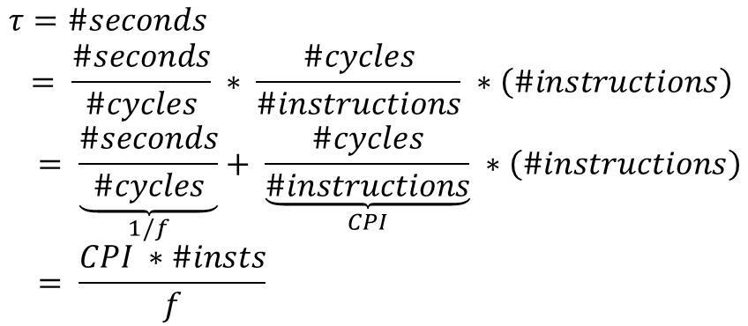
Computing the Time a Program Takes
$$τ=\#seconds \\ = \frac{\#seconds}{\#cycles} ∗ \frac{\#cycles}{\#instructions} ∗\left(\#instructions\right) \\ = \underset{1/f}{\underbrace{\frac{\#seconds}{\#cycles}}}+ \underset{CPI}{\underbrace{\frac{\#cycles}{\#instructions}}} ∗\left(\#instructions\right) \\ = \frac{CPI ∗\#insts}{f}$$
CPI → Cycles per instruction
f → frequency (cycles per second)

Slide 84
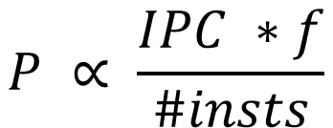
The Performance Equation
$$P ∝ \frac{IPC ∗f}{\#insts}$$
IPC → 1/CPI (Instructions per Cycle)
What are the units of performance ?
ANSWER : arbitrary

Slide 85
Number of Instructions (#insts)
Static Instruction: The binary or executable of a program, contains a list of static instructions.
Dynamic Instruction: A dynamic instruction is a running instance of a static instruction, which is created by the processor when an instruction
enters the pipeline.
Note that these are dynamic instructions
NOT static instructions
A smart compiler can reduce the number of executed instructions

Slide 86
Number of Instructions(#insts) – 2
Dead code removal
Often programmers write code that does not determine the final output
This code is redundant
It can be identified and removed by the compiler
Function inlining
Very small functions have a lot of overhead → call, ret instructions, register spilling, and restoring
Paste the code of the callee in the code of the caller (known as inlining)

Slide 87
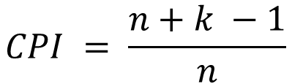
Computing the CPI
CPI for a single cycle processor = 1
CPI for an ideal pipeline(no hazards)
Assume we have n instructions, and k stages
The first instruction enters the pipeline in cycle 1
It leaves the pipeline in cycle k
The rest of the (n-1) instructions leave in the next (n-1) consecutive cycles
$$CPI = \frac{n+k −1}{n}$$

Slide 88
Computing the Maximum Frequency
Let the maximum amount of time that it takes to execute any instruction be :
t_{max} (also known as algorithmic work)
Minimum clock cycle time of a single cycle pipeline → t_{max}
In the case of a pipeline, let us assume that all the pipeline stages are balanced
Time per stage → t_{max} / k

Slide 89


Maximum Frequency - II
Let the latch delay be l
We thus have :
$$t_{stage}= \frac{t_{max}}{k}+l$$
The minimum cycle time (1/f) is equal
to t_{stage} . Let us thus, assume that
our cycle time is as low as possible.
$$\frac{1}{f}= \frac{t_{max}}{k}+l$$

Slide 90
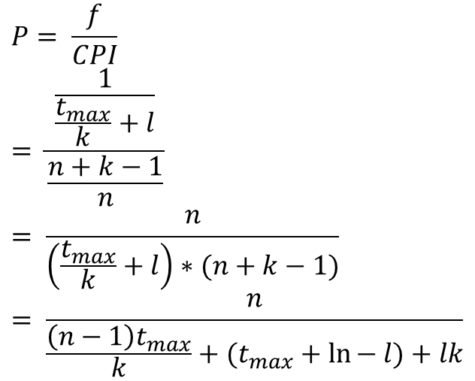
Performance of an Ideal Pipeline
Let us assume that the number of instructions are a constant
$$P= \frac{f}{CPI} \\ = \frac{\frac{1}{\frac{t_{max}}{k}+l}}{\frac{n+k−1}{n}} \\ = \frac{n}{\left(\frac{t_{max}}{k}+l\right)∗(n+k−1)} \\ = \frac{n}{\frac{\left(n−1\right)t_{max}}{k}+(t_{max}+\ln{− l)+lk}}$$

Slide 91

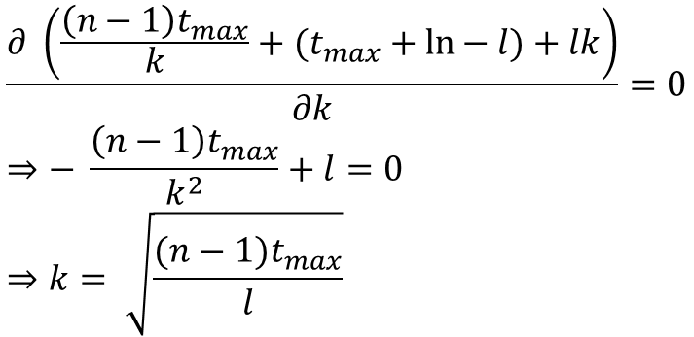
Optimal Number of Pipeline Stages
$$\frac{∂ \left(\frac{\left(n−1\right)t_{max}}{k}+(t_{max}+\ln{− l)+lk}\right)}{∂k}=0 \\ ⇒− \frac{\left(n−1\right)t_{max}}{k^{2}}+l=0 \\ ⇒k= \sqrt{\frac{(n−1)t_{max}}{l}}$$
k is inversely proportional to $\sqrt{l}$
k is proportional to $\sqrt{t_{max}}$

Slide 92
Implications
As we increase the latch delay, we should have less pipeline stages
We need to minimise the time wasted in accessing latches
As we increase the amount of algorithmic work, we require more pipeline stages for ideal performance
More pipeline stages help distribute the work better, and increase the overlap across instructions

Slide 93
Implications - II
As the number of instructions tends to ∞, the number of ideal pipeline stages also tends to ∞
The higher startup time gets amortized in the long run

Slide 94
A Non-Ideal Pipeline
Our ideal CPI (CPI_{ideal} = 1) is 1
However, in reality, we have stalls
Let us assume that the stall rate is a function of the program, and its nature of dependences
$$CPI= {CPI}_{ideal }+stall_rate∗stall_penalty$$

Slide 95
Non-Ideal Pipeline - II
Let us assume that the stall penalty is proportional to the number of pipeline stages
Both these assumptions are strictly not correct. They are being used to make a coarse grained mathematical model.
CPI = (n+k-1)/n + rck
r → stall rate, c → constant of proportionality

Slide 96
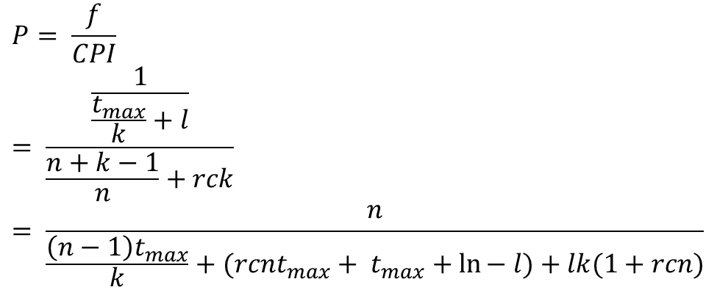
Mathematical Model
$$P= \frac{f}{CPI} \\ = \frac{\frac{1}{\frac{t_{max}}{k}+l}}{\frac{n+k−1}{n}+rck} \\ = \frac{n}{\frac{\left(n−1\right)t_{max}}{k}+(rcnt_{max}+ t_{max}+\ln{− l)+lk(1+rcn)}}$$

Slide 97
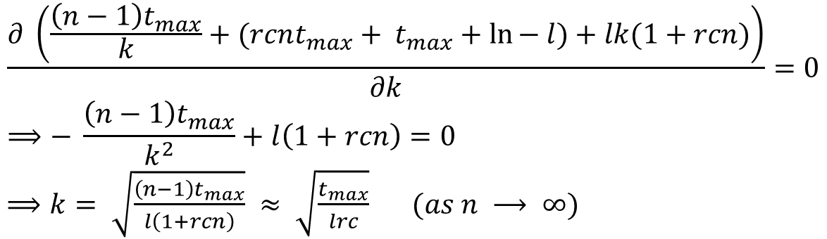
Mathematical Model - II
$$\frac{∂ \left(\frac{\left(n−1\right)t_{max}}{k}+(rcnt_{max}+ t_{max}+\ln{− l)+lk(1+rcn)}\right)}{∂k}=0 \\ ⟹− \frac{\left(n−1\right)t_{max}}{k^{2}}+l\left(1+rcn\right)=0$$ $⟹k= \sqrt{\frac{\left(n−1\right)t_{max}}{l\left(1+rcn\right)}} ≈ \sqrt{\frac{t_{max}}{lrc}} (as n ⟶ ∞)$

Slide 98
Implications
For programs with a lot of dependences (high value of r) → Use less pipeline stages
For a pipeline with forwarding → c is smaller (than a pipeline that just has interlocks)
It requires a larger number of pipeline stages for optimal performance

Slide 99
Implications
The optimal number of pipeline stages is directly proportional to √(t_{max} / l)
This ratio is not significantly changing across technologies.
This explains why the number of pipline stages has remained more or less constant for the last 5-10 years

Slide 100
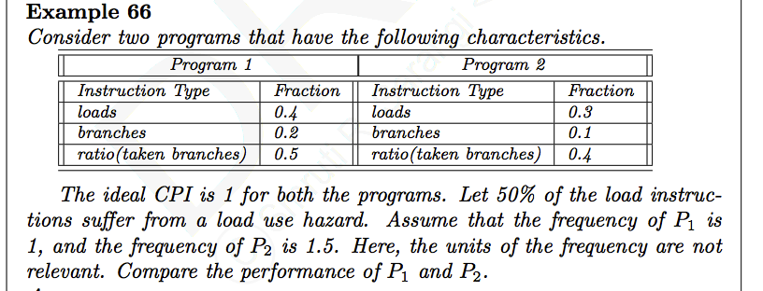
Example
Example Consider two programs that have the following characteristics.
Program 1 |  | Program 2
Instruction Type | Fraction | Instruction Type | Fraction
loads | 0.4 | loads | 0.3
Branches | 0.2 | Branches | 0.1
ratio(taken branches) | 0.5 | ratio(taken branches) | 0.4

Slide 101
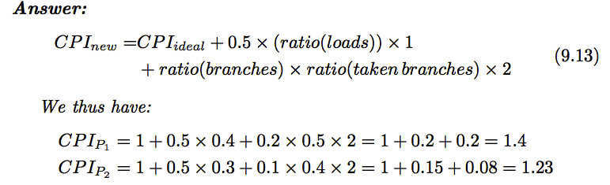
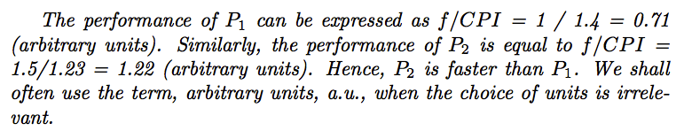
Example

Slide 102


Performance, Architecture, Compiler
P
f
IPC
Technology
Compiler
Architecture
Architecture

Slide 103
Outline
Overview of Pipelining
A Pipelined Data Path
Pipeline Hazards
Pipeline with Interlocks
Forwarding
Performance Metrics
Interrupts/ Exceptions

Slide 104
What happens when you press a key ?
The keyboard logs the key press
Converts the key to ASCII or Unicode
Sends the code to the processor
The processor thus receives an interrupt
It suspends the current program
Jumps to the interrupt handler.
The interrupt handler draws the shape associated with the key
The processor returns to execute the original program

Slide 105
Exceptions
Exceptions are generated when
A program accesses an illegal address
We try to divide 5/0
We issue an invalid instruction
…
Exception are treated the same way as interrupts
Jump to the exception handler
Come back and start executing programs

Slide 106
Precise Exceptions
Informal definition
We need to return to the original program at exactly the same point, at which we had left it
The execution of the interrupt handler should not disrupt the execution of the original program in any way. The outcome of the original program should be independent of the interrupt (unless the program caused an exception).

Slide 107
Precise Exceptions - II
Formal Definition
Let us number the dynamic instructions in a program : I₁ … I_{n}
Let us assume that an instruction completes after it either updates memory, writes to registers, or reaches the MA stage (cmp, b, beq, bgt, ret)
Let the last program instruction that completes before the first instruction in the interrupt handler completes, be I_{k}
Let all the program instructions that complete before the first instruction in the interrupt handler completes, be C

Slide 108

Precise Exceptions - III
$$I_{j} ∈C ⇔(j ≤k)$$
We need to ensure this condition.
Also no instruction of the form I_{k'} (k' > k) should complete before all the instructions in the interrupt handler complete
After returning, we can seamlessly execute I_{k}(same instruction)or I_{k+1} (next instruction)

Slide 109
Marking Instructions
When an interrupt arrives, let us mark the instruction in the MA stage
Otherwise, if there is an exception
We mark the instruction, as soon as it encounters a fault/exception
Once, an insruction is marked, we have two kinds of instructions in the pipeline
Instructions before/after the marked instruction

Slide 110
Implementing Precise Exceptions
Wait till a marked instruction reaches the end of the pipeline
Convert all the instructions after the marked instruction to bubbles
Ensures that both the conditions of a precise exception are met.
Once the marked instruction reaches the end of the pipeline, the exception unit loads the pc of the interrupt handler

Slide 111
Saving/Restoring Program State
Program State
PC
Registers
Flags
Memory
Memory → Assume that there is no overlap of memory regions, unless explicitly intended

Slide 112
oldPC Register
Let us add a npc field in the instruction packet
For taken branches it is equal to the branch target
For all other instructions it is equal to (pc + 4)
We populate the npc field in the EX stage
Depending on the type of the exception, we might want to return to pc or npc
The exception unit sets the oldPC register to the right return address

Slide 113
Spilling/ Restoring Registers
In the case of functions, we stored registers on the stack
In this case, the interrupt handler has a separate stack.
We cannot overwrite the stack pointer (we will lose its previous value)
Solution :
Use an additional register, oldSP, to save the stack pointer of the program.
Load the new stack pointer, and spill all the registers
Save oldPC

Slide 114
The Strange Case of the Flags
Naive solution :
Do not allow any instruction after the marked instruction to update the flags register
We detect an exception typically towards the middle or end of a cycle
By that time, the instruction might have already updated the flags register (at least the master latch)

Slide 115
Solution
Add a flags field to the instruction packet
Every instruction saves the updated value of the flags register to the flags field in its instruction packet.
The exception unit saves the flags field of the marked instruction to the oldFlags register
We store the oldFlags register to a location in the interrupt handler's stack

Slide 116
Privileged Instructions
We add the following new registers to the ISA
special registers → flags, oldFlags, oldPC, oldSP
The flags register is now accessible to the ISA
Add the z series of priveleged instructions
movz instruction
Transfers values between regular registers and special registers

Slide 117
Priveleged Instructions - II
retz
pc ← oldPC
The z series instructions can only be used by the interrupt handler, and the operating system
We use a CPL bit (current privelege level) bit for setting permissions
User programs (CPL = 1)
Interrupt handlers, kernel programs, (CPL = 0)

Slide 118
Implementing movz and retz
Define two new opcodes
These opcodes are usable only when CPL = 0
Augment the OF and RW stages to use the special registers.
movz, and retz see a different view of registers.
Register | Encoding
r0 | 0000
oldPC | 0001
oldSP | 0010
flags | 0011
oldFlags | 0100
sp | 1110

Slide 119
Assembly Code for Spilling Registers
/* save the stack pointer */
movz oldSP, sp
mov sp, 0x FF FC
/* spill all the registers other than sp*/
st r0, -4[sp]
st r1, -8[sp]
st r2, -12[sp]
st r3, -16[sp]
st r4, -20[sp]
st r5, -24[sp]
st r6, -28[sp]
st r7, -32[sp]
st r8, -36[sp]
st r9, -40[sp]
st r10, -44[sp]
st r11, -48[sp]
st r12, -52[sp]

Slide 120
Spilling Registers - II
st r13, -56[sp]
st r15, -60[sp]
/* save the stack pointer */
movz r0, oldSP
st r0, -64[sp]
/* save the flags register */
movz r0, oldFlags
st r0, -68[sp]
/* save the oldPC */
movz r0, oldPC
st r0, -72[sp]
/* update the stack pointer */
sub sp, sp, 72
/* code of the interrupt handler */
....
....
....

Slide 121
Restoring Registers
/* update the stack pointer */
add sp, sp, 72
/* restore the oldPC register */
ld r0, -72[sp]
movz oldPC, r0
/* restore the flags register */
ld r0, -68[sp]
movz flags, r0
/* restore all the registers other than sp*/
ld r0, -4[sp]
ld r1, -8[sp]
ld r2, -12[sp]
ld r3, -16[sp]
ld r4, -20[sp]
ld r5, -24[sp]
ld r6, -28[sp]
ld r7, -32[sp]
ld r8, -36[sp]

Slide 122
Restoring Registers – II
ld r9, -40[sp]
ld r10, -44[sp]
ld r11, -48[sp]
ld r12, -52[sp]
ld r13, -56[sp]
ld r15, -60[sp]
/* restore the stack pointer */
ld sp, -64[sp]
/* return to the program */
retz

Slide 123

PC of exception handler
bubble
isBranchTaken
Branch-lock Unit
CPL
Exception unit
stall
Data-lock Unit
(pc/npc), flags
Control
Branch
Memory
unit
unit
unit
Fetch
Immediate
Register
unit
and branch
flags
write unit
IF-OF
unit
OF-EX
EX-MA
Data
MA-RW
Register unit
ALU
memory
Instruction
Register
op2
unit
memory
file
op1
op2
oldFlags
oldPC
oldSP
flags
Forwarding unit

Slide 124
THE END

